Slide 1
Air Quality Prediction
Predicting the Air Quality Index of Indian cities using regression models
Group 12 : Achalesh Nimbiwal (MS24255), Peehu (MS24191), Vaibhav (MS24090)
IISER Mohali

Slide 2
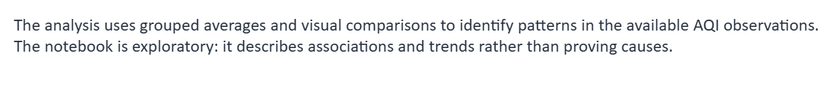
Introduction and Objectives
Background
Objectives
Air pollution is a major environmental concern in India. The Air Quality Index (AQI) summarizes pollution levels in a single number, based on measured pollutant concentrations.
Analyze air-quality data from Indian cities.
Predict AQI from pollutant concentrations using three regression models.
Tune the models and compare them using MAE, RMSE, and R².
Build separate next-day AQI models for six cities.

Slide 3
Dataset
The dataset is India Air Quality Data (2015-2020) from Kaggle.
The file AQI_data.csv contains one row for each city on each day.
The target variable is AQI.
The inputs for Part I are twelve pollutant measurements.
Group | Pollutants
Particulate matter | PM2.5, PM10
Nitrogen compounds | NO, NO2, NOx, NH3
Gases | CO, SO2, O3
Organic compounds | Benzene, Toluene, Xylene

Slide 4
Project Workflow
1. Load and clean
The dataset is downloaded, and missing values are handled.
2. Create features
Date and season features are added to the data.
3. Explore the data
City trends, correlations, and monthly patterns are plotted.
4. Part I models
AQI is predicted from twelve pollutant readings.
5. Part II models
Next-day AQI is predicted for each of six cities.
Parts I and II use the same cleaned dataset but answer different questions.

Slide 5
Data Cleaning Pipeline
1. Load the data
city_day.csv is downloaded with kagglehub.
2. Drop missing AQI
Rows without the target value are removed.
3. Fill pollutants
Missing values are replaced with the column median.
4. Run quality checks
Nulls, duplicates, city names, and date type are checked.
5. Convert dates
The Date column is converted to datetime.
The result was saved as AQI_data and used in all later steps.

Slide 6
Data Preparation
Cleaning
Feature creation
Rows with a missing AQI value were removed.
Missing pollutant values were filled with the median of each pollutant.
The data was checked for null values, duplicate rows, and inconsistent city names.
The Date column was converted to the datetime format.
Year, month, day, and weekday were extracted from the date.
A season label and a winter indicator were added.

Slide 7
Handling Missing Pollutant Values
Missing values in the twelve pollutant columns were filled with the median of each column.
The median was chosen because extreme values affect it less than they affect the mean.
After imputation, the null count of each pollutant column was printed to verify the result.
One overall median was used for each pollutant, not a separate median for each city.
Rows with a missing AQI value were removed first, because AQI is the target variable.

Slide 8
Feature Engineering
Feature | Created from | Description
Year | Date | Calendar year
Month | Date | Month number, from 1 to 12
Day | Date | Day of the month
Weekday | Date | Name of the day of the week
Season | Month | Winter (Dec-Feb), Spring (Mar-May), Summer (Jun-Aug), Monsoon (Sep-Nov)
Winter | Month | 1 for December to February, otherwise 0
Season labels follow standard Northern Hemisphere months.

Slide 9
From Data to Model Input
1. Cleaned data
AQI_data with twelve pollutants and AQI.
2. Inputs and target
The pollutants are the inputs, and AQI is the target.
3. Train-test split
80% for training and 20% for testing (random_state = 42).
4. Model training
Linear Regression, Decision Tree, and Random Forest.
All twelve features were kept, because the correlation analysis did not justify removing any of them. Performance was measured on the test set.

Slide 10
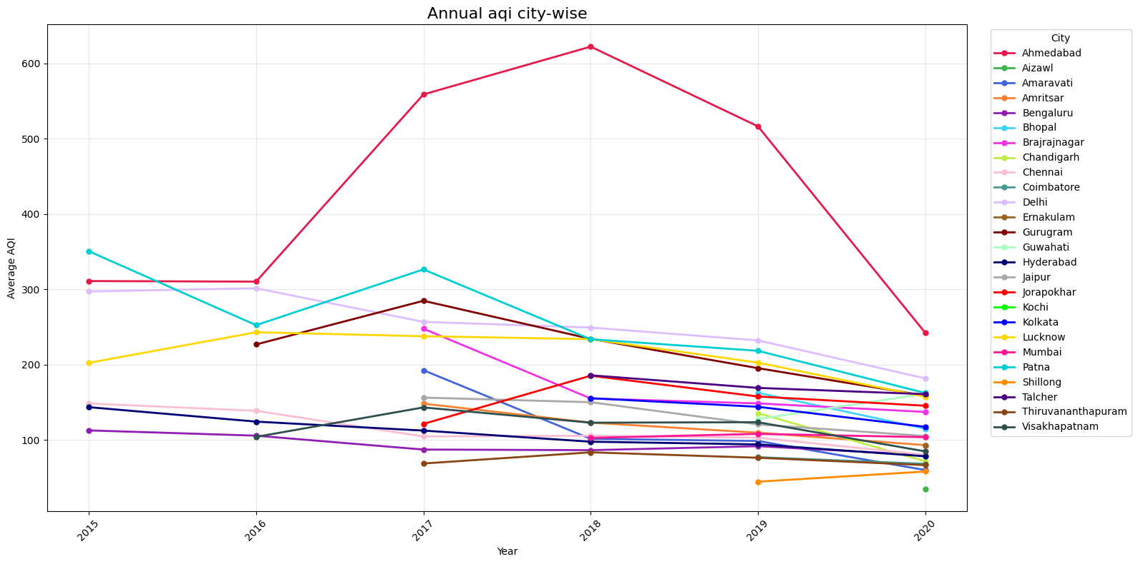
Annual average AQI of every city
EXPLORATORY DATA ANALYSIS (CITY-WISE AQI )
Ahmedabad is the clear outlier, and most cities improve by 2020.
This chart shows the yearly average AQI of all 26 cities, from 2015 to 2020.
Ahmedabad peaks above 600 in 2018, far above every other city.
Delhi, Patna, Gurugram and Lucknow stay between 200 and 350 for most years.
Bengaluru, Chennai and Hyderabad stay near or below 150.
Some lines start late because those cities have no earlier data, for example Chandigarh begins in 2019.

Slide 11
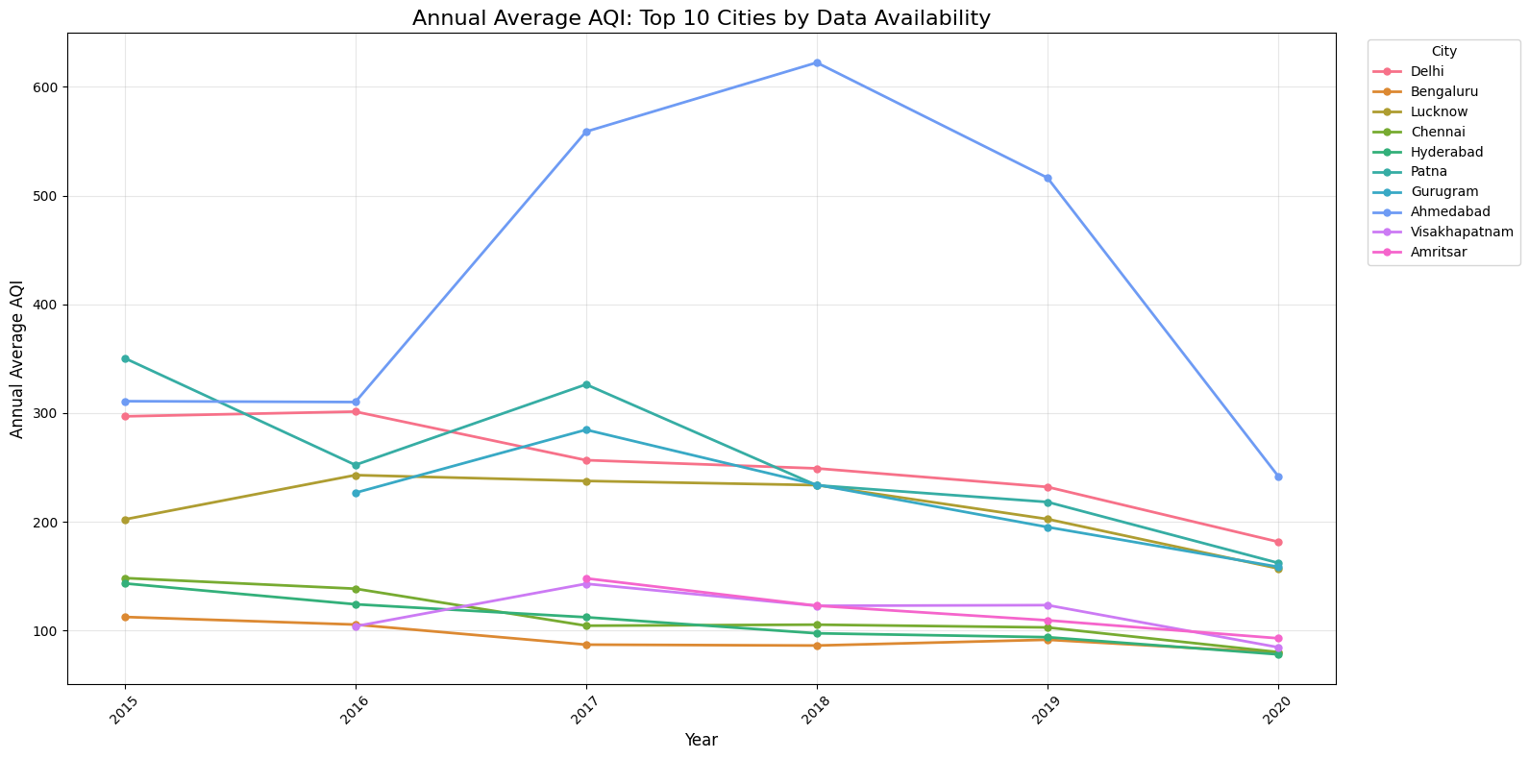
Top 10 cities by data availability
CITY-WISE AQI
Using the 10 cities with the most readings keeps the comparison fair.
We kept the 10 cities with the most recorded AQI days, between 1,126 and 1,999 readings each.
Ahmedabad is highest again: about 622 in 2018, then a sharp fall to about 240 in 2020.
Delhi falls steadily, from about 297 in 2015 to about 182 in 2020.
Bengaluru stays among the lowest, under about 115 every year.
Selection rule: count of non-missing AQI values per city, top 10.

Slide 12
AQI ranking of the top 10 cities
CITY-WISE AQI
Rank | City | Readings | Average AQI
1 | Ahmedabad | 1,334 | 452.12
2 | Delhi | 1,999 | 259.49
3 | Patna | 1,459 | 240.78
4 | Gurugram | 1,453 | 225.12
5 | Lucknow | 1,893 | 217.97
6 | Amritsar | 1,126 | 119.92
7 | Visakhapatnam | 1,171 | 117.27
8 | Chennai | 1,884 | 114.50
9 | Hyderabad | 1,880 | 109.21
10 | Bengaluru | 1,910 | 94.32
HIGHEST
LOWEST
452
94
Ahmedabad
Bengaluru
Ahmedabad’s average AQI is about 4.8 times Bengaluru’s.
Delhi, Patna, Gurugram and Lucknow form a second group, all above 200.
The other five cities sit close together, between about 94 and 120.
Average AQI is the mean of all daily readings, 2015–2020.

Slide 13
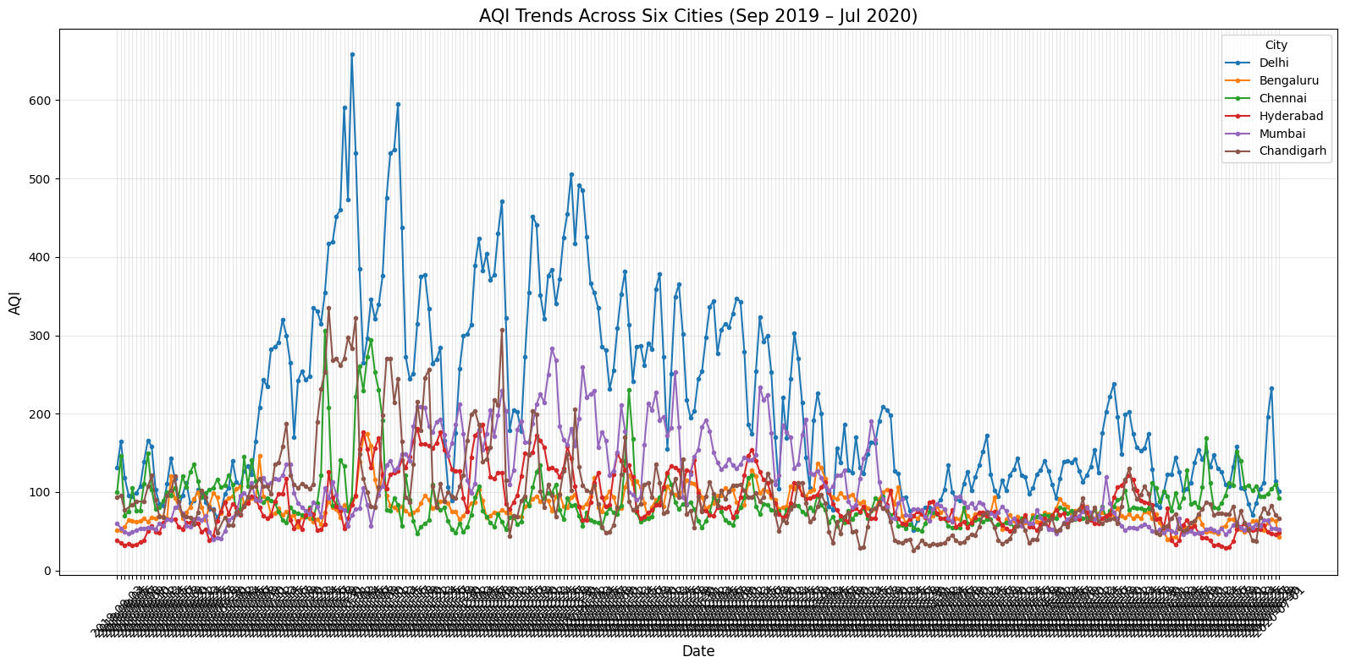
Daily AQI in six cities, Sep 2019 – Jul 2020
CITY-WISE AQI
Delhi swings far above the other five cities.
Now I zoom into six cities, one point for every day.
Delhi spikes to about 660 and stays above 200 for most of the winter.
Bengaluru, Chennai and Hyderabad stay mostly below 150 the whole time.
From about April 2020 every city settles lower, which likely reflects the COVID-19 lockdown.
The daily line is noisy, so the next slide averages it by month.

Slide 14
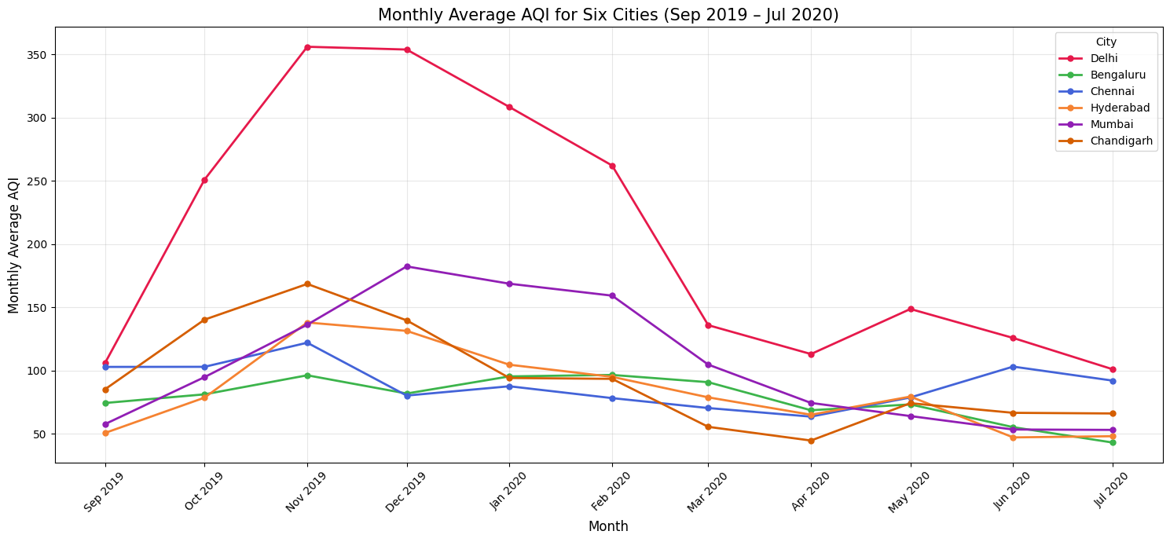
Monthly average AQI in the same six cities
CITY-WISE AQI
Delhi peaks in November, and every city is lower by April.
Averaging by month removes the daily noise and shows the seasonal shape clearly.
Delhi jumps from about 106 in September to about 356 in November, and stays above 300 until January.
Chandigarh peaks in November (about 168), Mumbai a little later in December (about 182).
By April 2020 the six cities fall to between about 45 and 113.
Monthly average = mean of all daily AQI values in that month.

Slide 15
Yearly and Monthly Trends
PART 2
How AQI rises and falls through the year in each city

Slide 16
Two ways to look at AQI across the year
YEARLY AND MONTHLY TRENDS
WITHOUT AVERAGING
WITH AVERAGING
Daily AQI, one line per year
Monthly average, one line per year
X-axis runs January to December; every year is drawn on top of the others.
Shows the sharp daily spikes and the exact days a city turned very bad.
Each point is the mean AQI of one month, for one city and one year.
Smoother, so the seasonal shape and year-to-year change are easy to compare.
Say this: “For every city We plotted each year in its own colour, so we can ask two questions: which months are worst, and is a given month getting better over the years?”
What the six-city data already showed: northern cities peak from October to January and are cleanest in July and August.
Presenter tip: these per-city charts are hidden in the notebook output, so re-run those cells and show one or two cities live, for example Delhi.
Notes:
One chart is made per city, so there are many charts. Do not read them all: open the notebook and show Delhi and one southern city such as Bengaluru, then move on.

Slide 17
City-wise Comparison
PART 3
GROUP 1
GROUP 2
Delhi · Chandigarh · Mumbai
Chennai · Hyderabad · Bengaluru
For each group: yearly AQI, seasonal AQI, pollutant levels and monthly pattern.

Slide 18
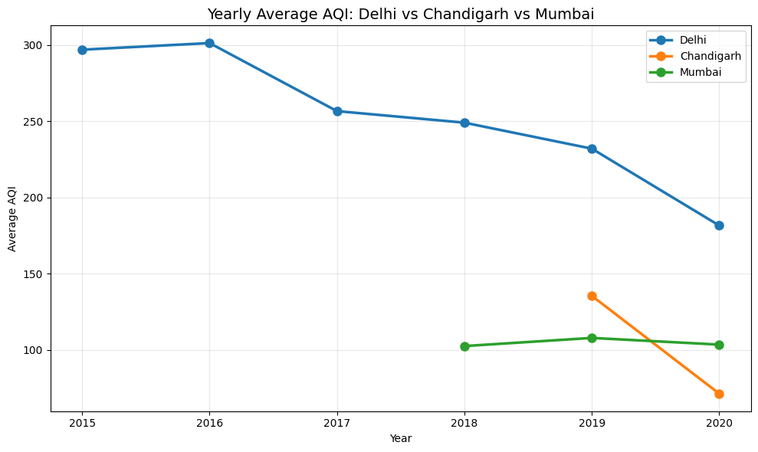
Yearly average AQI
GROUP 1 · DELHI, CHANDIGARH, MUMBAI · YEARLY
Delhi is the highest every year, but it keeps improving.
Delhi fell from 297 in 2015 to 182 in 2020, about 39 percent lower.
Chandigarh has data only from 2019, and dropped from 136 to 71, about 47 percent lower.
Mumbai is almost flat at 103 to 108 from 2018 to 2020.
Delhi: 2015 to 2020 data. Mumbai: 2018 onward. Chandigarh: 2019 onward.

Slide 19
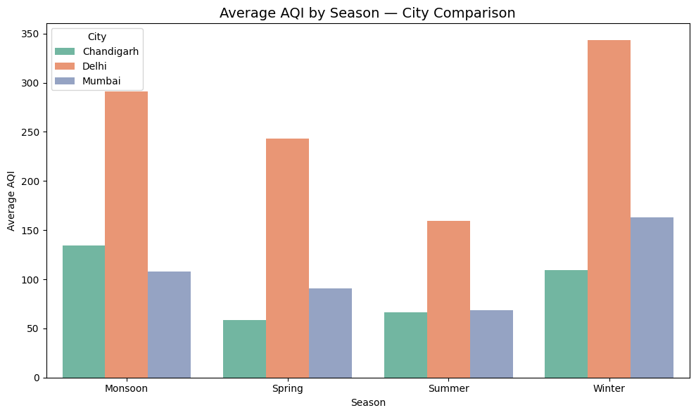
Average AQI by season
GROUP 1 · DELHI, CHANDIGARH, MUMBAI · SEASONAL
Winter is worst for Delhi and Mumbai, and Delhi is highest in every season.
Delhi is about 343 in winter and about 159 in summer, more than double.
Mumbai is about 163 in winter and about 68 in summer.
Chandigarh is lowest in spring (about 58) and highest in monsoon (about 134).
Notes:
If asked: Delhi monsoon about 291 and Chandigarh monsoon about 134 contradict the monthly plot, where July and August are the lowest months. Most likely the Season column places October and November in Monsoon. Worth checking the Season definition in the notebook.

Slide 20
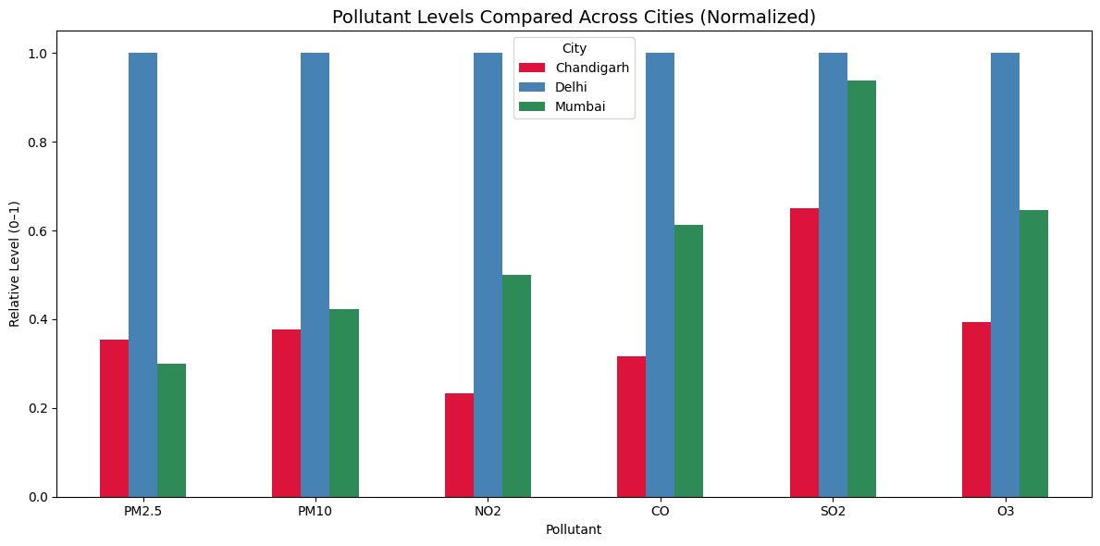
Pollutant levels compared
GROUP 1 · DELHI, CHANDIGARH, MUMBAI · POLLUTANTS
Delhi has the highest level of every pollutant, and PM2.5 is about 3 times the others.
Each pollutant is divided by its maximum, so the highest city always shows 1.0.
PM2.5: Delhi 117.5, Chandigarh 41.6, Mumbai 35.2. PM10: Delhi 228, Chandigarh 86, Mumbai 97.
SO2 is the closest: Mumbai 14.6 is near Delhi 15.6.
So fine particles most likely drive Delhi’s very high AQI.
Average of daily readings. Pollutants: PM2.5, PM10, NO2, CO, SO2, O3.

Slide 21
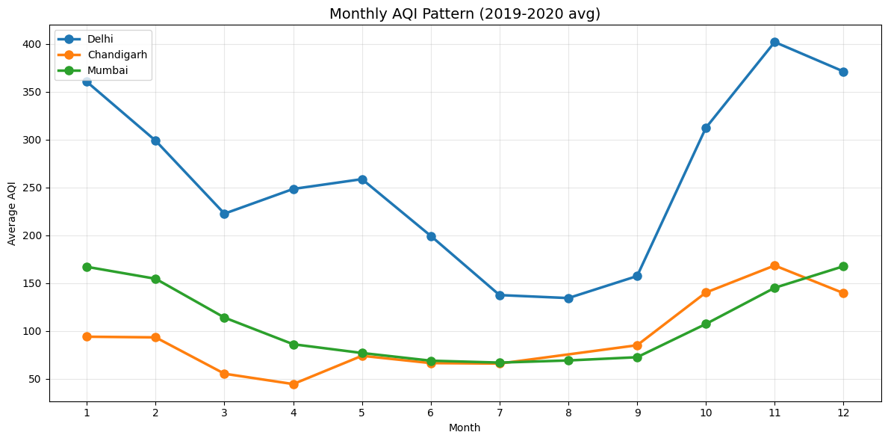
Monthly AQI pattern
GROUP 1 · DELHI, CHANDIGARH, MUMBAI · MONTHLY
All three cities are worst from November to January and cleanest in the summer and monsoon months.
Delhi peaks in November at about 402 and is lowest in August at about 134.
Mumbai peaks in December and January at about 167, and is lowest in July at about 67.
Chandigarh peaks in November at about 168 and is lowest in April at about 45.
Winter pollution is a repeating pattern, not a one-off event.
Month 1 = January … 12 = December. Average over all available years.

Slide 22
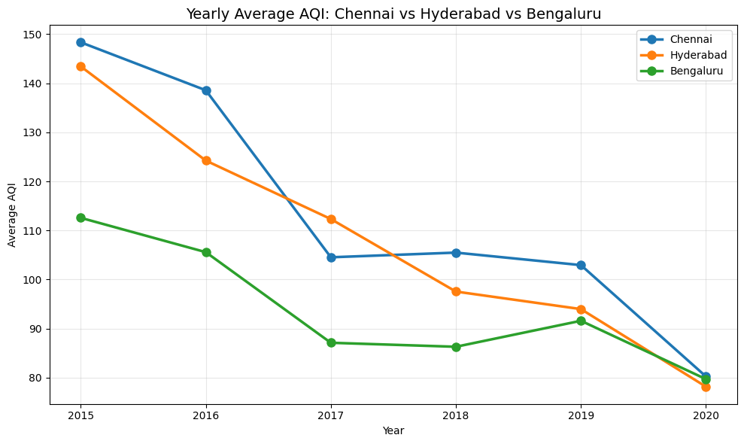
Yearly average AQI
GROUP 2 · CHENNAI, HYDERABAD, BENGALURU · YEARLY
All three southern cities improve steadily and meet at about 80 in 2020.
Chennai fell from 148 to 80, about 46 percent lower.
Hyderabad fell from 143 to 78, about 45 percent lower.
Bengaluru fell from 113 to 80, about 29 percent lower.
Bengaluru is the lowest from 2015 to 2019, but in 2020 all three are within about 2 points.
Compare with Group 1: Delhi was 182 even in 2020.

Slide 23
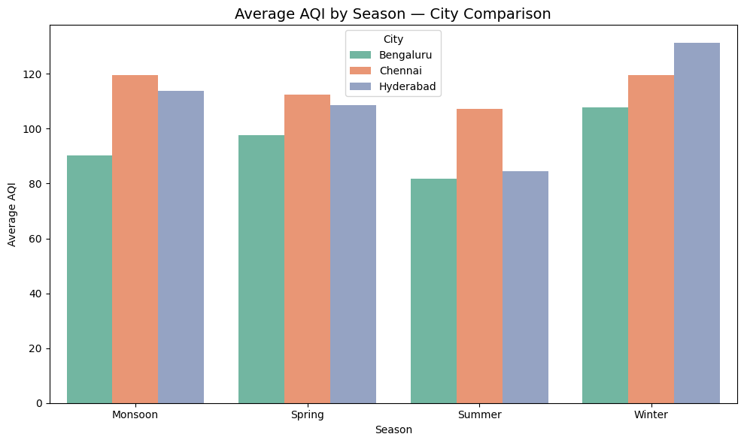
Average AQI by season
GROUP 2 · CHENNAI, HYDERABAD, BENGALURU · SEASONAL
Seasonal swings are mild compared with the north.
Hyderabad has the biggest swing: about 131 in winter against about 85 in summer.
Bengaluru is about 108 in winter and about 82 in summer.
Chennai is almost flat, between about 107 and 120, and is highest in monsoon, spring and summer.
For scale, Delhi’s winter-to-summer gap is about 185 points, Hyderabad’s only about 45.
Seasons as defined in the dataset’s Season column.

Slide 24
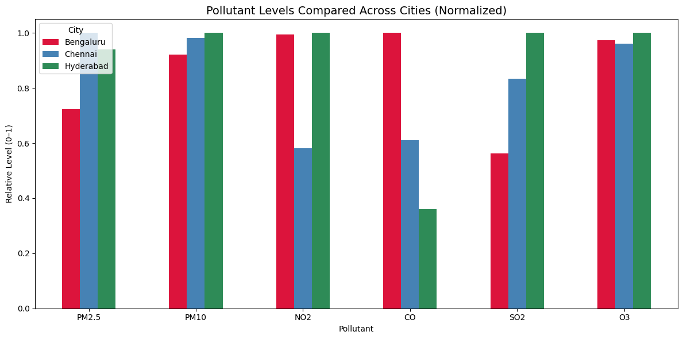
Pollutant levels compared
GROUP 2 · CHENNAI, HYDERABAD, BENGALURU · POLLUTANTS
The three cities have similar AQI, but different pollutant profiles.
Chennai has the highest PM2.5 (50.2), then Hyderabad (47.1) and Bengaluru (36.2).
Bengaluru has the highest CO (1.67), almost 3 times Hyderabad (0.60).
Chennai has the lowest NO2 (16.6), while the other two are near 28.
Hyderabad has the highest SO2 (9.3). PM10 and O3 are almost the same in all three.
Each pollutant divided by its maximum across the three cities.

Slide 25
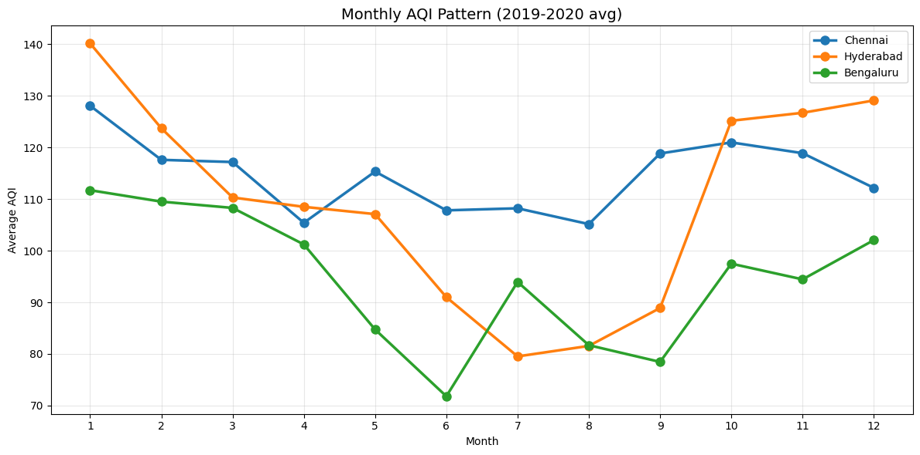
Monthly AQI pattern
GROUP 2 · CHENNAI, HYDERABAD, BENGALURU · MONTHLY
AQI is higher from October to January and lowest in the middle of the year.
Hyderabad is highest in January at about 140 and lowest in July at about 80, then rises again from October.
Bengaluru is lowest in June at about 72 and highest in January at about 112.
Chennai stays in a narrow band, about 105 to 128, all year.
Cleaner mid-year months are likely linked to monsoon rain.
Month 1 = January … 12 = December. Average over all available years.

Slide 26
What the data tells us
SUMMARY
1
Ahmedabad has the highest AQI (452 average), Bengaluru the lowest (94).
2
AQI improved in almost every city from 2015 to 2020, by roughly 30 to 47 percent in the cities we compared.
3
Northern cities have a strong winter peak (Oct–Jan), driven by fine particles. Southern cities vary far less.
4
Every city dropped in spring 2020, which likely reflects the COVID-19 lockdown.

Slide 27
Exploratory Analysis
Yearly average AQI was plotted for every city and for the ten cities with the most records.
Daily and monthly AQI were compared for Delhi, Mumbai, Chandigarh, Bengaluru, Chennai, and Hyderabad from September 2019 to July 2020.
Box plots showed the distribution of each pollutant, and a correlation heatmap showed the relationships between pollutants.
The monthly plots showed a seasonal pattern, with AQI generally lower in the summer months.
These plots do not explain the cause of the seasonal pattern.

Slide 28
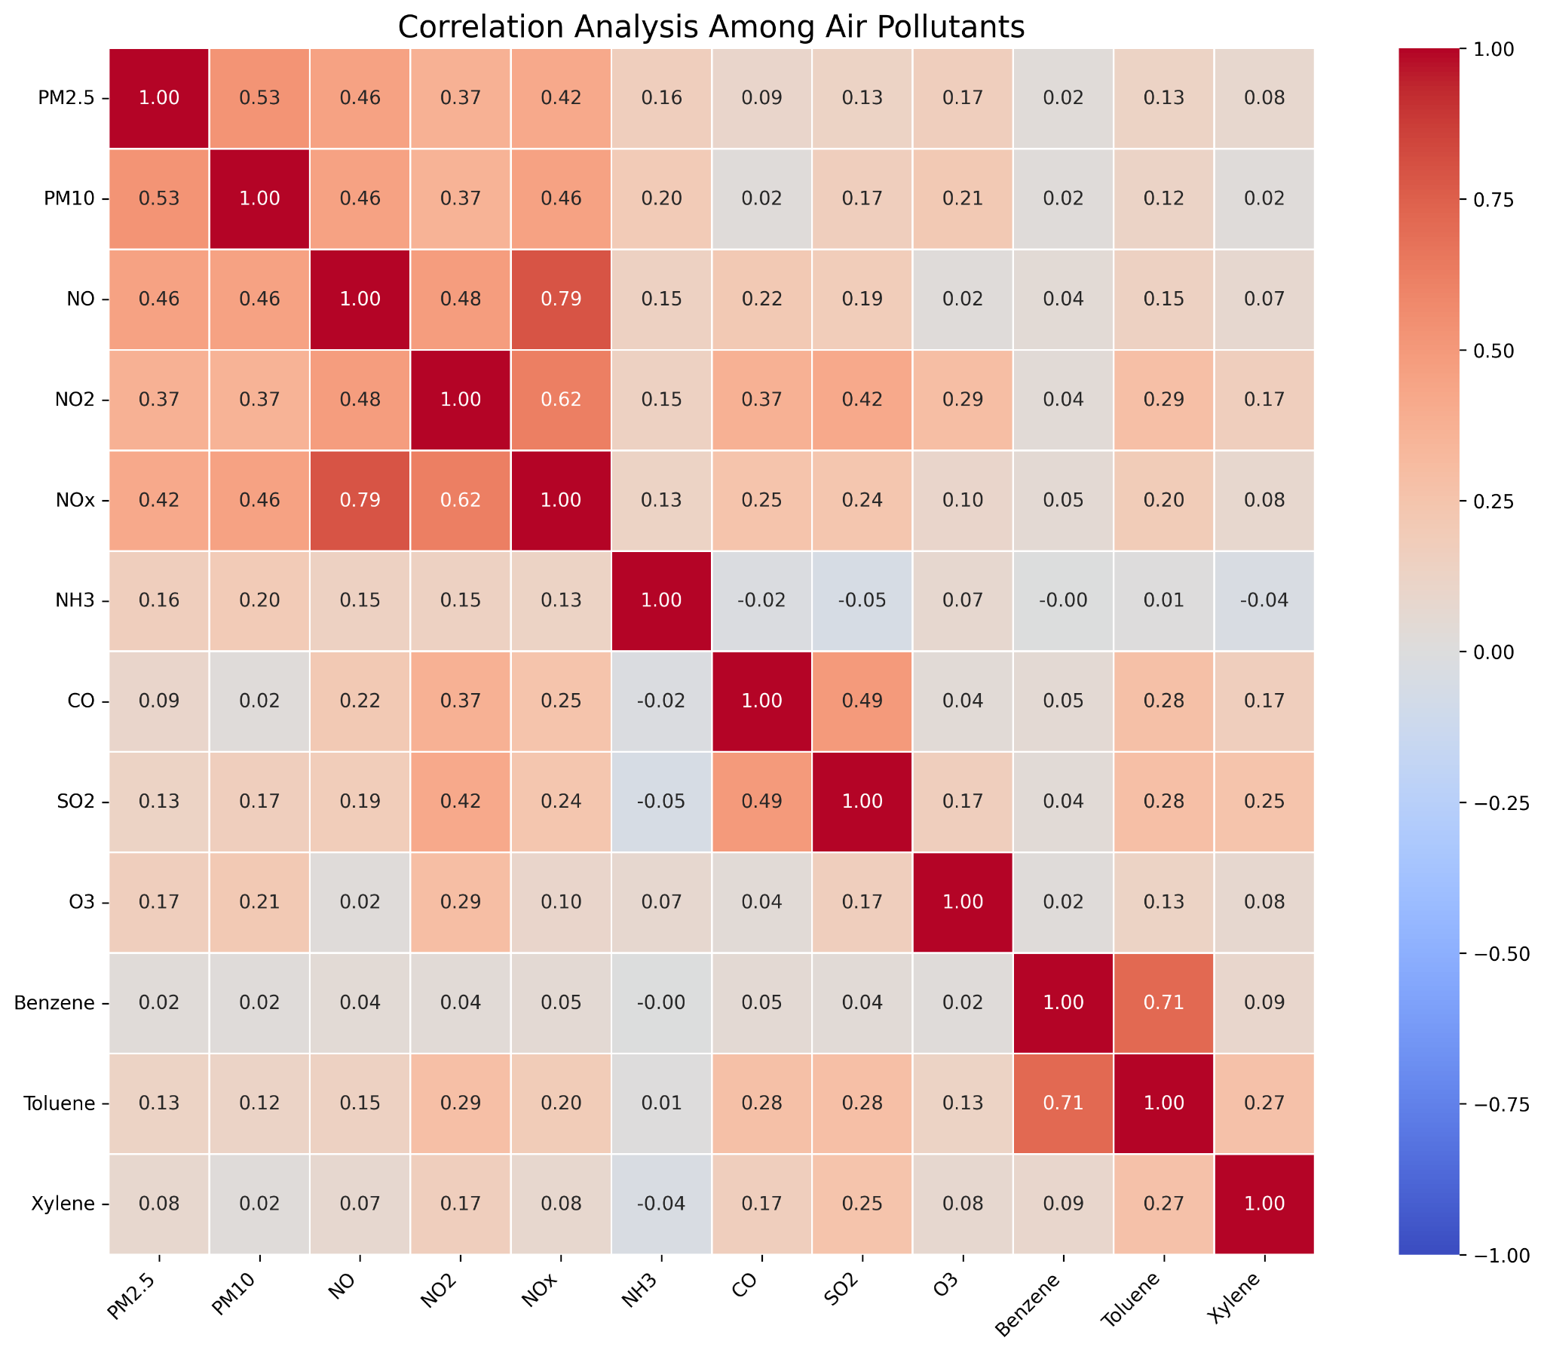
Correlation Between Pollutants

Slide 29
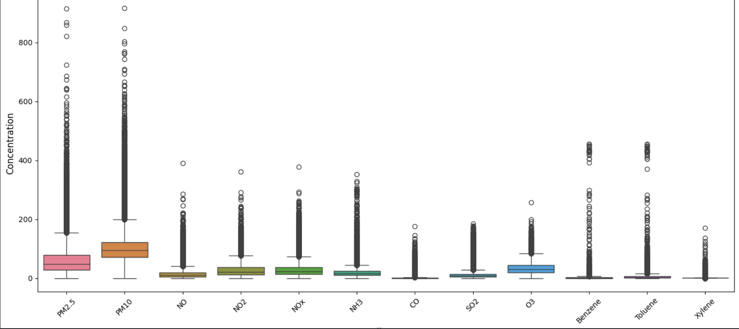
Distribution of Pollutant Values

Slide 30
Part I: Models and Settings
The twelve pollutants were the inputs, and AQI was the target.
The data was split 80/20 into training and test sets (random_state = 42).
Hyperparameters of the Decision Tree and Random Forest were tuned with RandomizedSearchCV.
Model | Settings
Linear Regression | Baseline model
Decision Tree | max_depth = 10, min_samples_leaf = 20, min_samples_split = 2
Random Forest | n_estimators = 120, max_depth = 20, max_features = 0.5, min_samples_split = 10, min_samples_leaf = 1, bootstrap = True

Slide 31
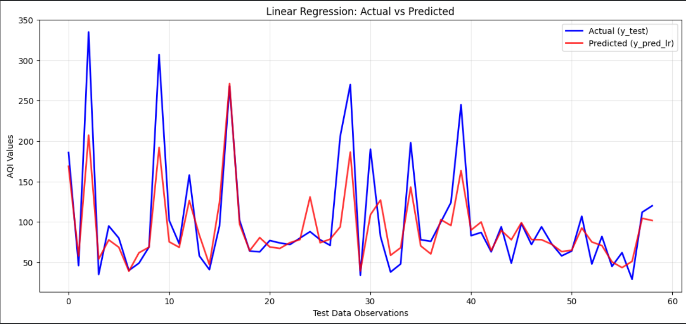
Linear Regression: Actual vs Predicted

Slide 32
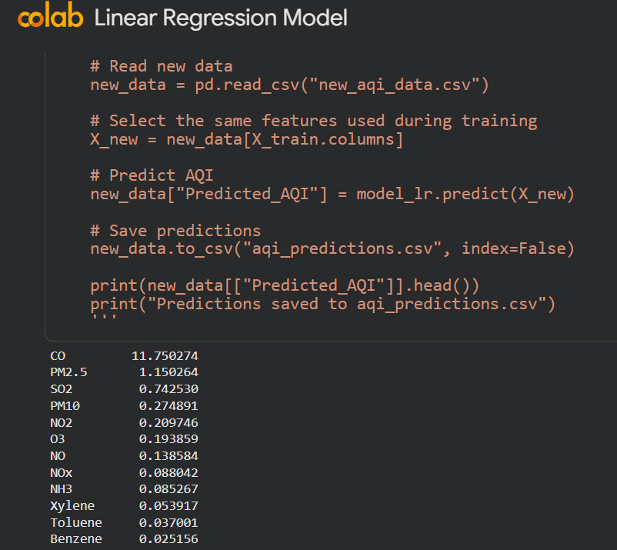
Linear Regression: Prediction and Coefficients

Slide 33
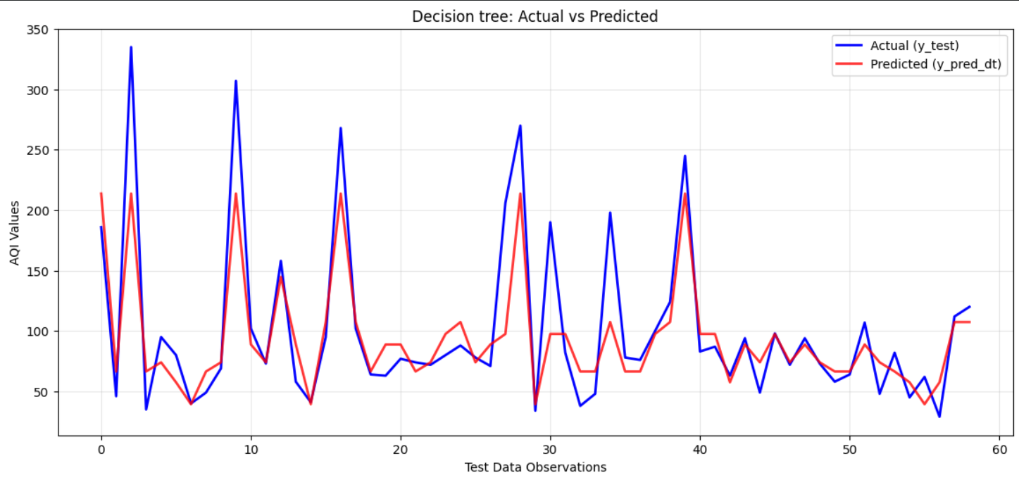
Decision Tree: Actual vs Predicted

Slide 34
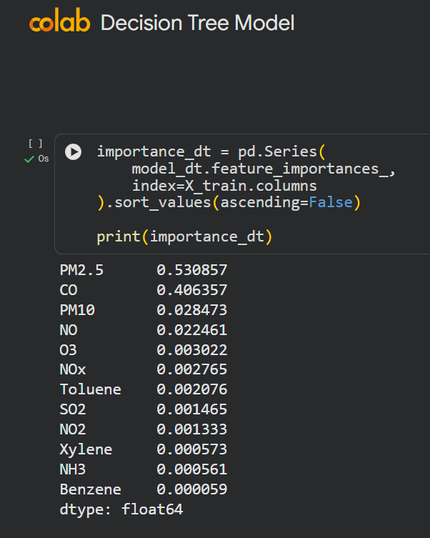
Decision Tree: Feature Importance

Slide 35
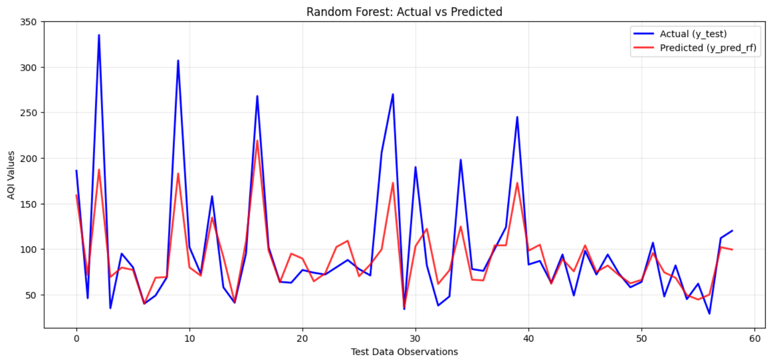
Random Forest: Actual vs Predicted

Slide 36
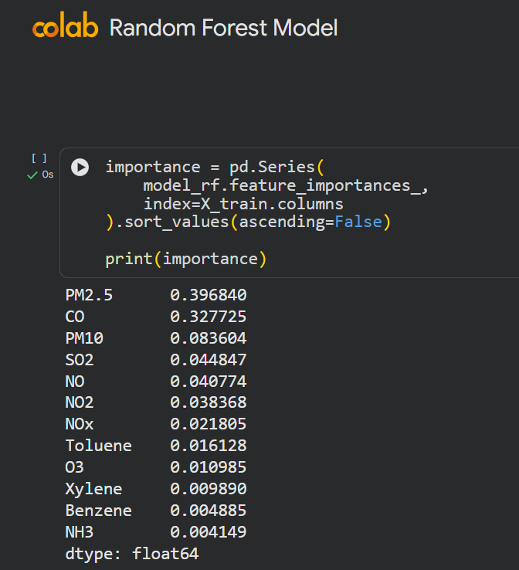
Random Forest: Feature Importance

Slide 37
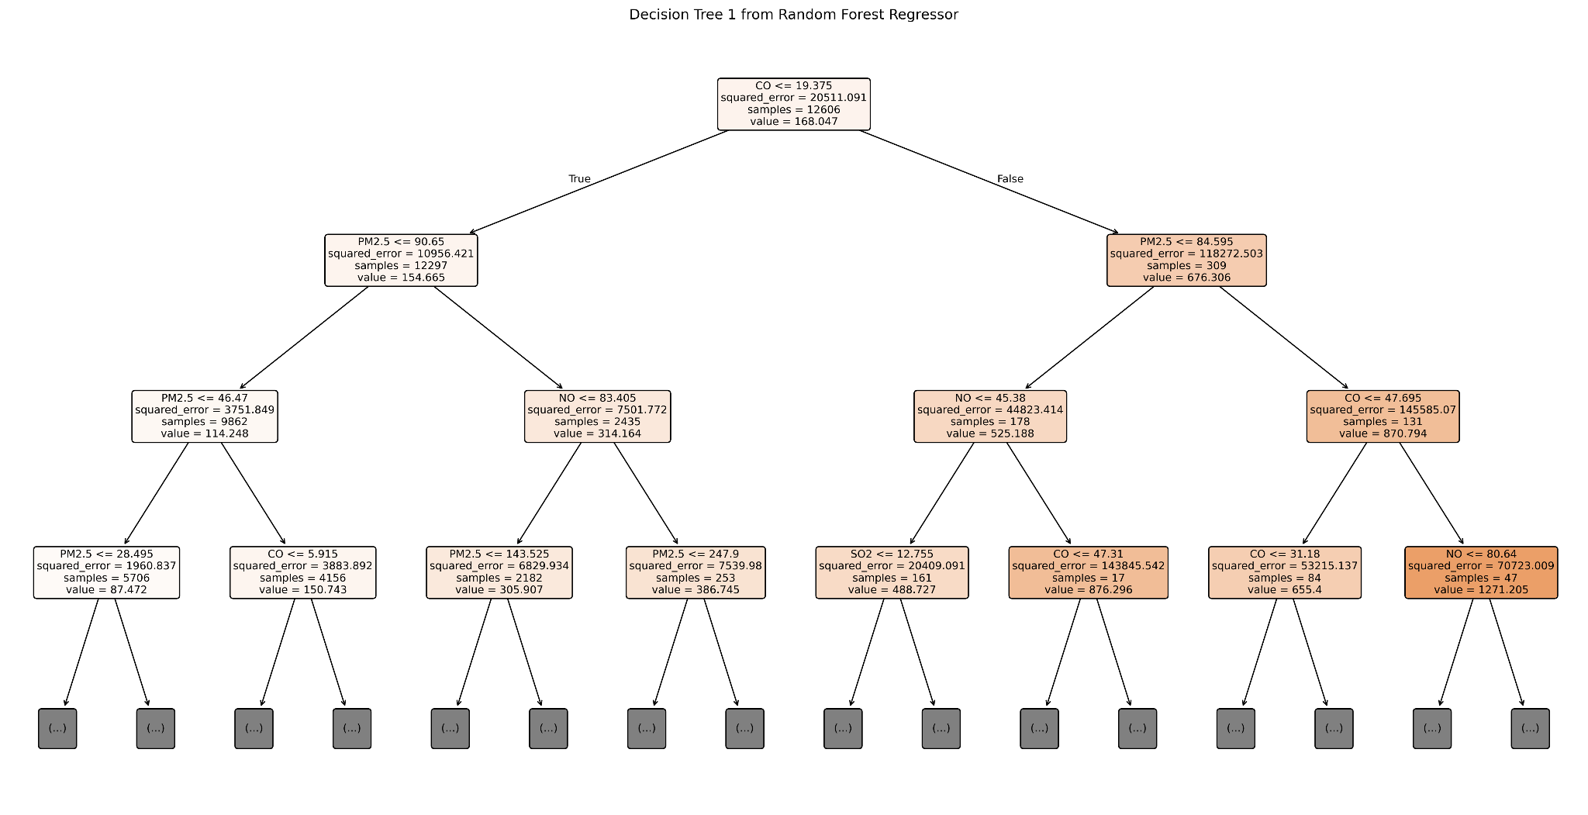
One Tree from the Random Forest

Slide 38
Part I: Results
Model | MAE | RMSE | R²
Linear Regression | 31.17 | 59.44 | 0.807
Decision Tree | 24.45 | 45.21 | 0.888
Random Forest | 20.54 | 40.31 | 0.911
Random Forest achieved the lowest errors and the highest R².
Linear Regression, the baseline, had the largest errors.
MAE is the average error, RMSE penalizes large errors more strongly, and R² is the share of AQI variation explained.
Lower MAE and RMSE and a higher R² indicate better performance.

Slide 39
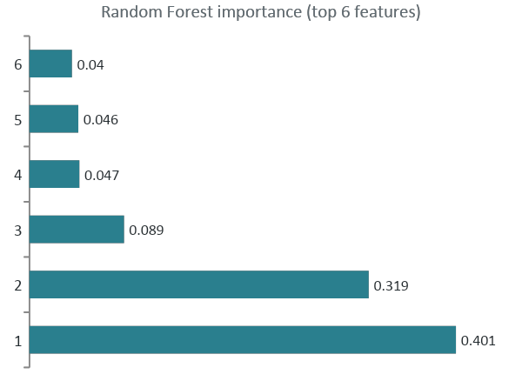
Part I: Feature Importance
PM2.5 and CO were the most important features in both the Decision Tree and the Random Forest.
In Linear Regression, CO had the largest coefficient magnitude.
All twelve features were kept, because the analysis did not justify removing any of them.
Importance describes how a model uses its inputs. It does not prove that a pollutant causes a change in AQI.

Slide 40
Part II: Why City-Specific Models
AQI patterns can differ between cities because of emission sources, local conditions, seasonal behavior, and historical pollution trends.
A single model trained on combined data may not capture the behavior of every city equally well.
Therefore, six separate Random Forest models were trained, one for each city.
Each model uses the past AQI values of its own city to predict the next day.
The cities are Bengaluru, Chennai, Hyderabad, Delhi, Mumbai, and Chandigarh.

Slide 41
Part II: Next-Day Prediction Pipeline
1. Select a city
The user enters one of the six city names.
2. Filter the data
Only the rows of that city are kept.
3. Order by date
Daily AQI values are arranged in time order.
4. Build features
Lag values and rolling means are calculated.
5. Tune the model
RandomizedSearchCV selects the Random Forest settings.
6. Evaluate and predict
Test metrics are reported, and the next day is predicted.

Slide 42
Part II: Next-Day AQI Method
Feature | Description
AQI_lag_1 | AQI one day earlier
AQI_lag_2 | AQI two days earlier
AQI_lag_3 | AQI three days earlier
AQI_lag_7 | AQI seven days earlier
AQI_rolling_mean_3 | Mean AQI over three days
AQI_rolling_mean_7 | Mean AQI over seven days
A separate Random Forest model was trained for each of six cities: Bengaluru, Chennai, Hyderabad, Delhi, Mumbai, and Chandigarh.
Each city dataset was ordered by date, and the lag features and rolling means were calculated from its past AQI values.
RandomizedSearchCV selected the hyperparameters for each city.
The final model predicts the AQI of the day after the latest record.

Slide 43
Part II: Tuned Hyperparameters
City | n_estimators | max_depth | max_features | min_samples_split | min_samples_leaf | bootstrap
Bengaluru | 50 | 5 | 0.7 | 8 | 10 | True
Delhi | 75 | None | 1.0 | 10 | 8 | True
Hyderabad | 150 | None | 1.0 | 15 | 8 | True
Mumbai | 125 | 15 | 0.7 | 10 | 8 | False
Chandigarh | 150 | 30 | 1.0 | 10 | 2 | True
Chennai | 50 | 5 | 0.7 | 8 | 10 | True
Each city has its own optimized settings, which reflects the differences in how AQI behaves across cities.

Slide 44
Part II: Results by City
City | CV MAE | Test MAE | Test RMSE | Test R²
Bengaluru | 20.56 | 9.19 | 12.40 | 0.600
Delhi | 45.57 | 32.75 | 44.66 | 0.846
Hyderabad | 18.26 | 11.35 | 15.35 | 0.814
Mumbai | 20.86 | 11.80 | 18.08 | 0.825
Chandigarh | 31.06 | 12.44 | 15.69 | 0.223
Chennai | 26.98 | 18.13 | 26.04 | 0.475
Delhi had the highest test R² (0.846), but also the largest absolute errors.
Bengaluru had the lowest test MAE (9.19), although its R² was 0.600.
Chandigarh had an MAE of 12.44 but the weakest R² (0.223).
These differences show why more than one metric is needed.
CV MAE is the best cross-validation error found during tuning.

Slide 45
Part II: Making a Forecast
1. Choose a city
The user types the name of one of the six cities.
2. Prepare the inputs
The latest AQI history of that city is used to compute the features.
3. Predict
The trained model returns the AQI for the next day.
The final model for each city was trained on all available rows of that city.
The forecast is for the day after the latest record in the dataset. The data ends in 2020, so it is not a forecast for today.

Slide 46
Limitations and Future Work
Limitations
Future work
The pollutant-based models estimate AQI but do not forecast it.
The data ends in 2020 and includes the COVID-19 lockdown period.
Lag features cannot capture sudden changes caused by weather or emissions.
Feature importance and correlation do not prove cause and effect.
Add weather variables such as temperature, humidity, wind speed, and rainfall.
Compare the city-wise models with a single pooled model.
Test other time-series forecasting methods.
Extend the analysis to more cities and newer data.

Slide 47
Conclusion
Random Forest gave the best pollutant-based estimates, with an MAE of 20.54, an RMSE of 40.31, and an R² of 0.911.
PM2.5 and CO were the most important features in the tree-based models.
Six city-wise Random Forest models were built for next-day AQI prediction, and their performance varied from city to city.
Together, the two parts show how AQI can be estimated from pollutants and forecast from past AQI values.
Special thanks to Dr. Vishal Bhardwaj, Chatgpt, and Claude

Slide 48
Group 12
Project: Air Quality Prediction
Team member | Roll number
Achalesh Nimbiwal | MS24255
Peehu | MS24191
Vaibhav | MS24090
IISER Mohali

Slide 49
Thank you
Questions?

